Slide 1
Introduction
Data Driven Decisionmaking
INTR 490
COLL 200

Slide 2


Slide 3
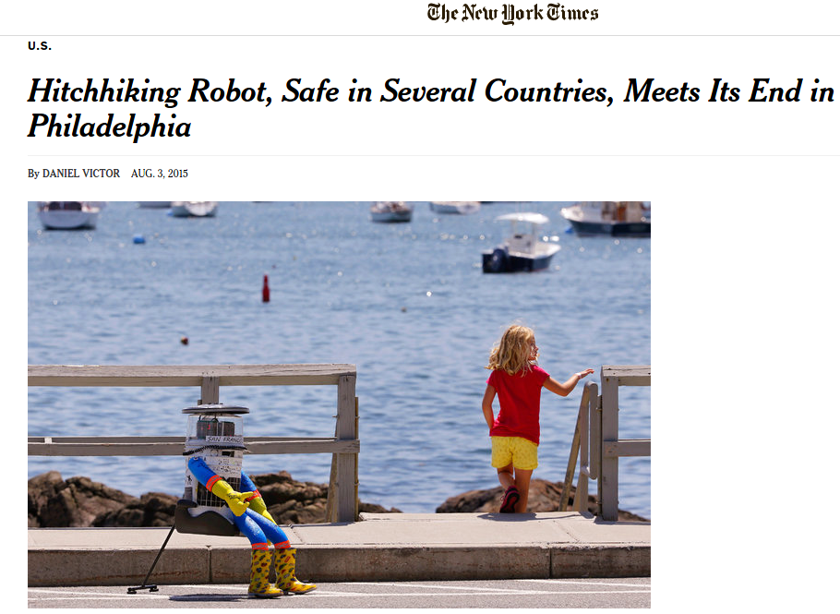

Slide 4
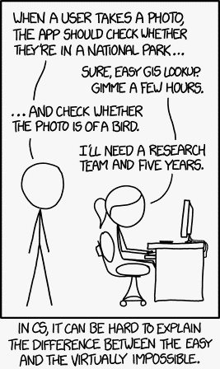

Slide 5
452*12

Slide 6

http://www.theinvisiblegorilla.com/gorilla_experiment.html

Slide 7
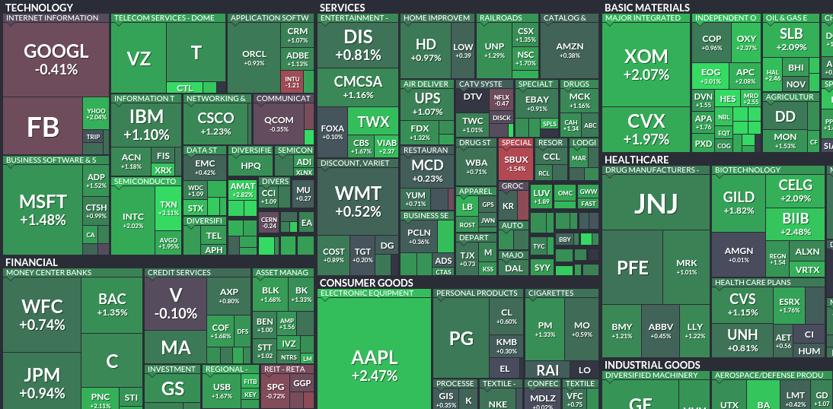


Slide 8
452*12 = 5,424 by the way

Slide 9
So, what?
This course is all about giving you the skill to leverage data in a real world case.
Today, we're going to take a brief tour through the variety of data in decisionmaking.
The first half of the semester, you'll work on a real world project for which all the data and methods already exist.
The second half of the semester, in groups you will work with a partner organization (Save the Children, World Bank, US Army Corps, White House OSTP) to work on an unsolved problem.

Slide 10



Slide 11




Slide 12
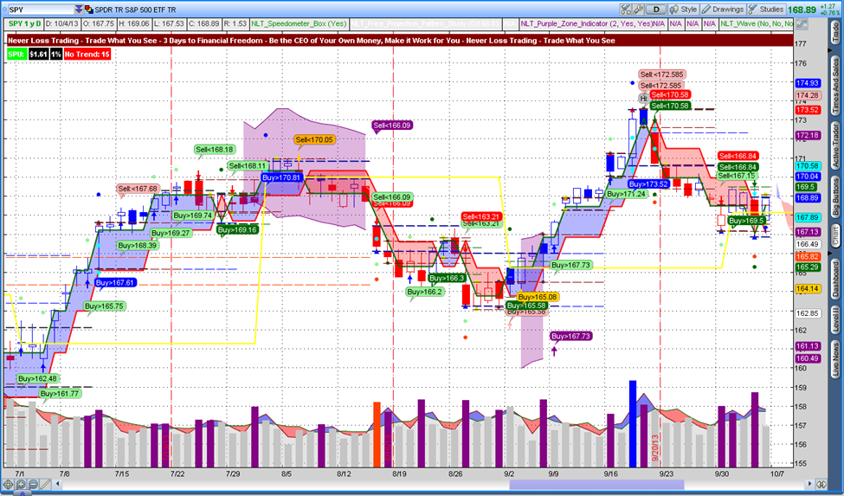

Slide 13
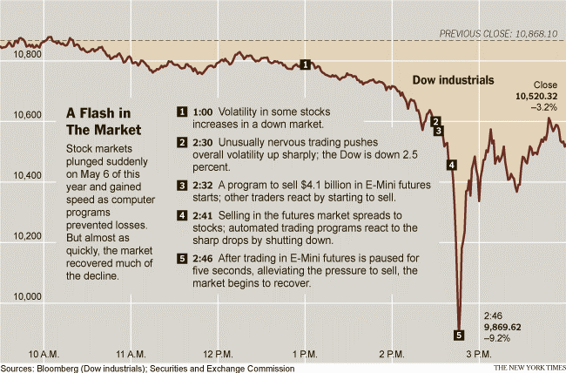

Slide 14


Slide 15
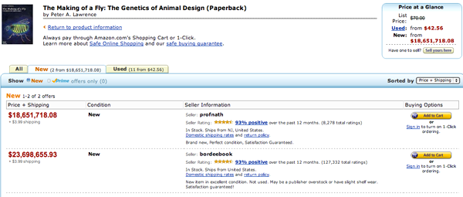

Slide 16

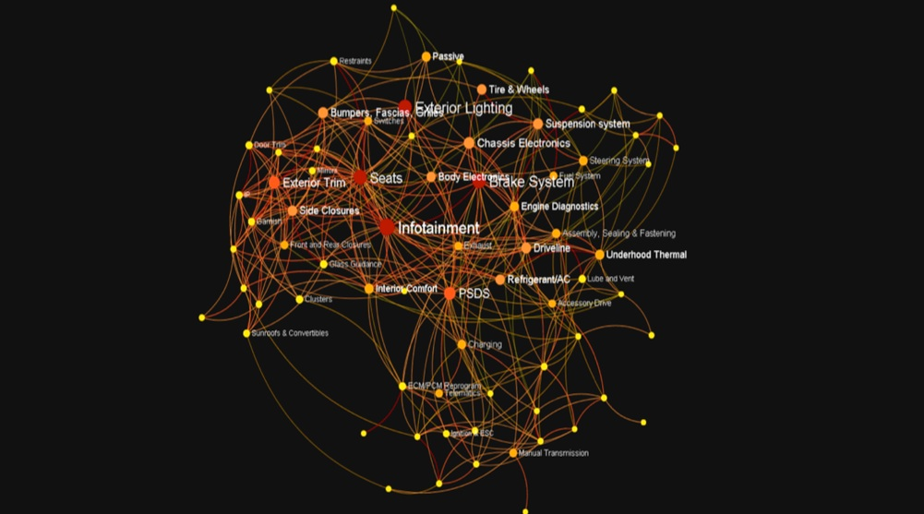

Slide 17


Slide 18
This is all great, but is big data just around to get better dates and make a ton of money?

Slide 19
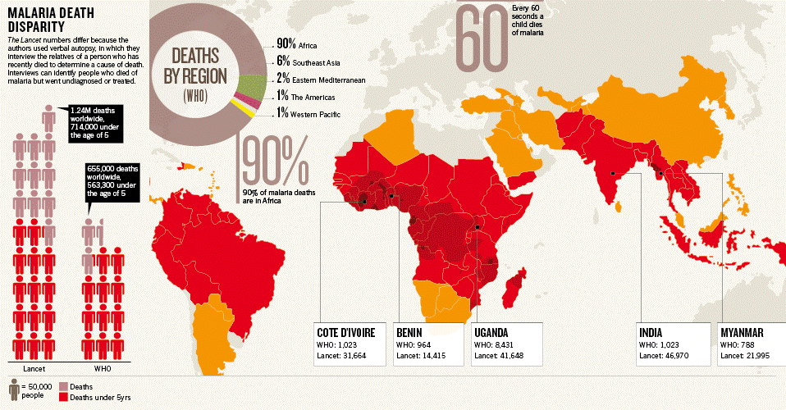

Slide 20


Slide 21


Slide 22


Slide 23

http://www.intellectualventures.com/

Slide 24
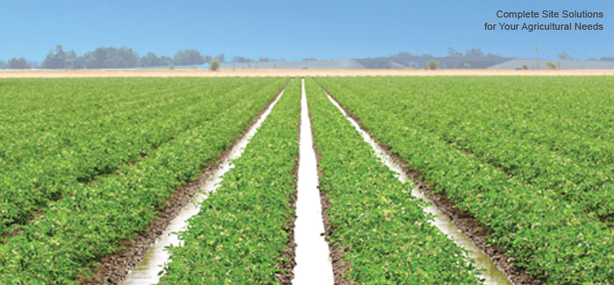

Slide 25
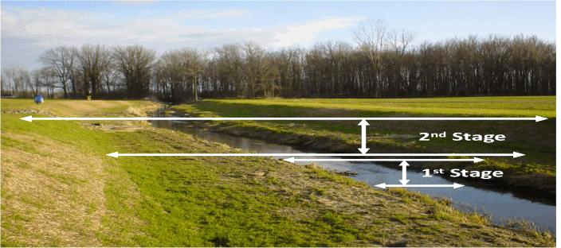

Slide 26
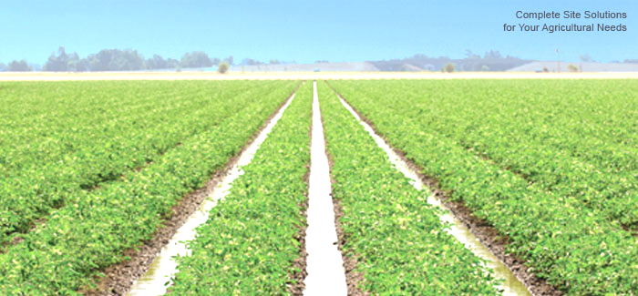
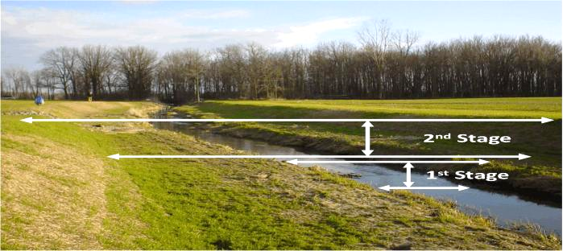
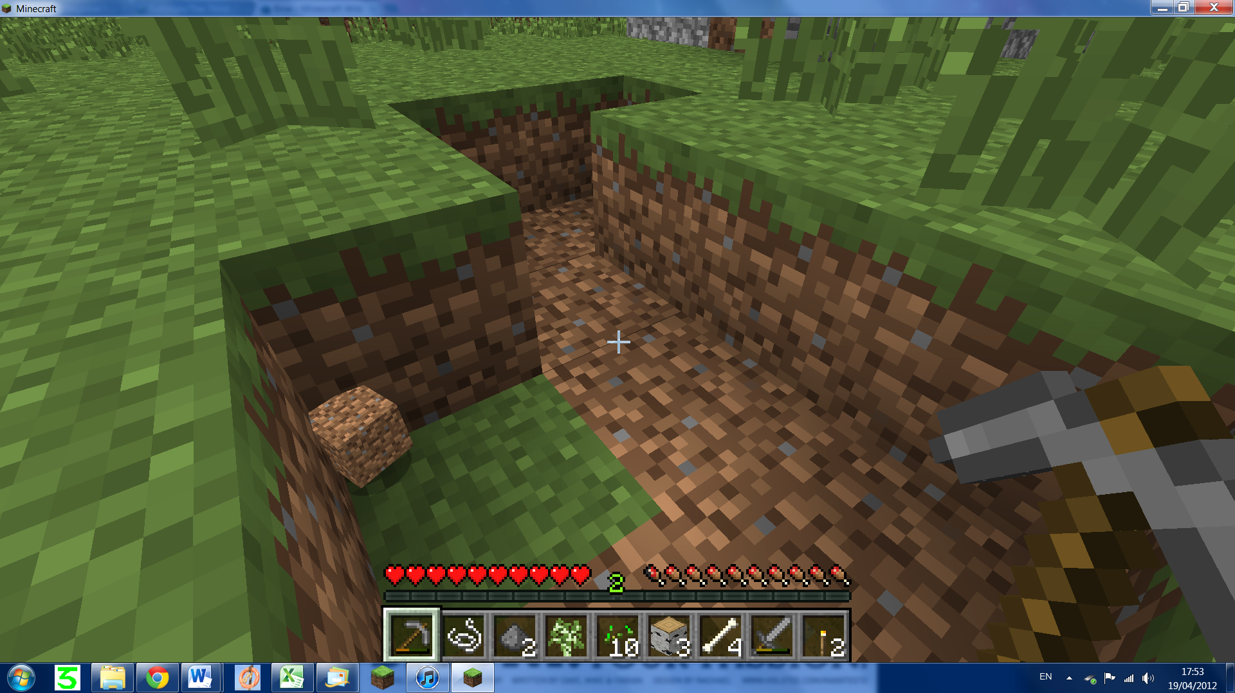

Slide 27


Slide 28
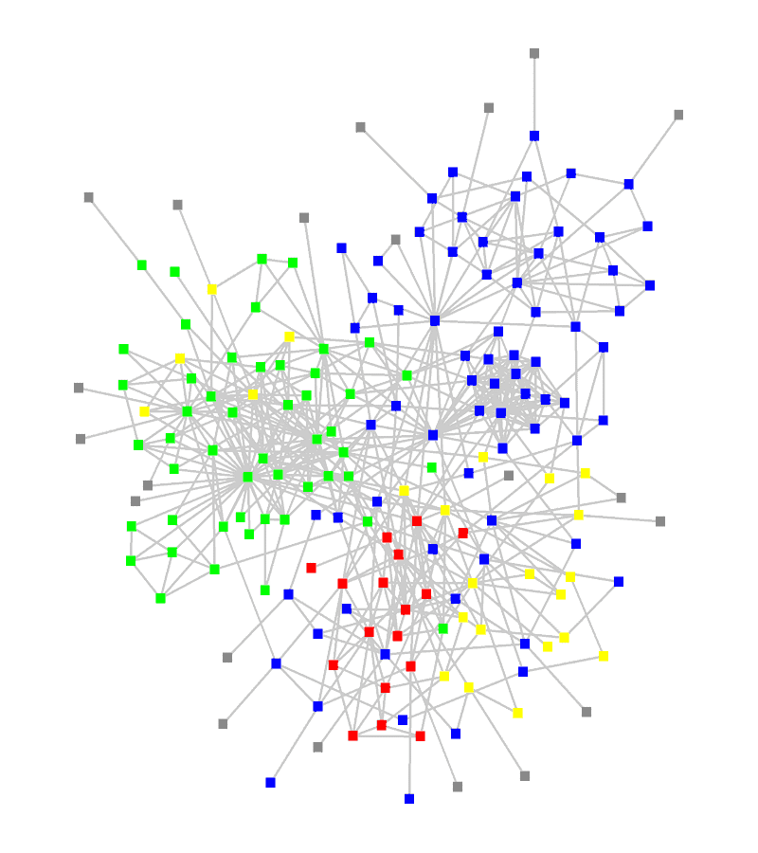

Slide 29
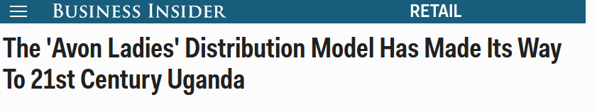
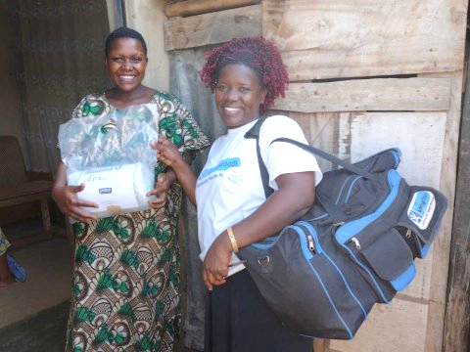

Slide 30
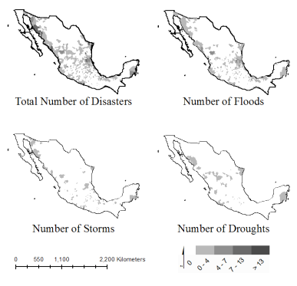

Slide 31
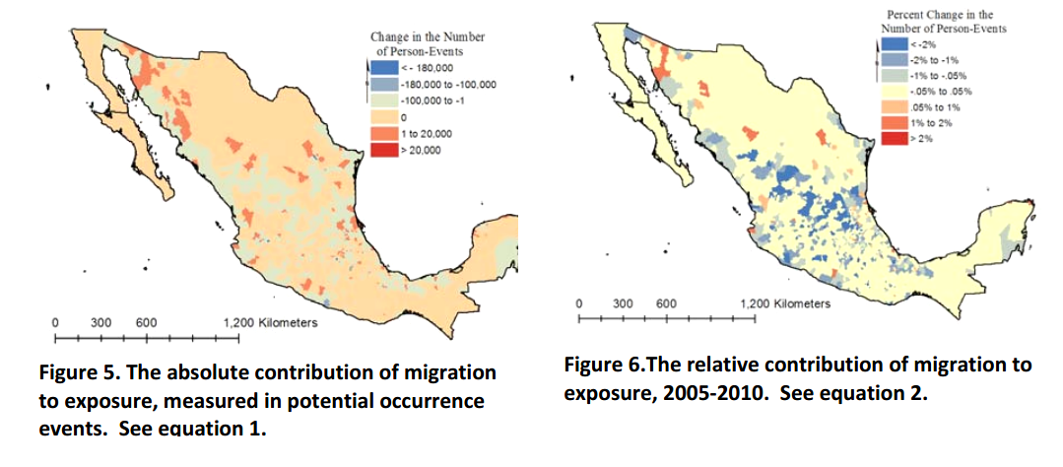

Slide 32
From Here
First Half: Learning the Methods in an Applied Context
Second Half: Choose from a Question that Interests you
World Bank – Environmental Change & Emissions
Save the Children – Health, Safety, and Child Deprivation in Urban Areas
National Center for State Courts - Metrics of Procedural Legal Justice

Slide 33
Syllabus

